Slide 1


Flask role-based authorization with Keycloak

Slide 2
Agenda
Why use Keycloak
Delegate authentication with Authorization code flow
Setup Keycloak
Setup Flask app

Slide 3
Why use Keycloak with Flask
Users database, login screen, user registration, two factor etc.
Security best practices out of the box & configured easily with admin portal
Need not maintain a database to securely store user data
Single Sign On (SSO) possible for multiple web applications with Keycloak since user logins are handled by Keycloak

Slide 4
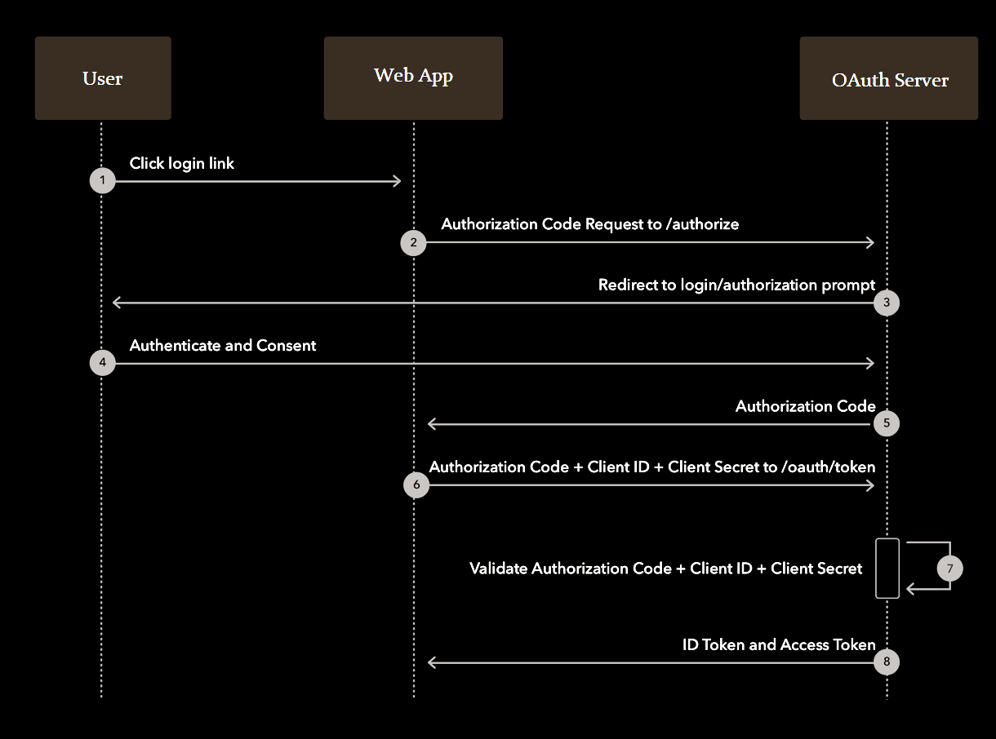
Workflow for authentication

Slide 5
Setup Keycloak (OAuth Server)
Create a realm
Create a client for flask application
Create user roles
Include user roles in user info endpoint and id token
Create users in realm
Assign roles to users

Slide 6


Authentication in Flask app with Keycloak
4. User session set in cookie
3. User details sent to app after login
1. User clicks login link in app page
2. App redirects user to Keycloak login page
Flask App
Keycloak
Server

Slide 7
Role based authorization overview
User details & roles will be embedded in a flask session (implemented with cookies)
Whenever the user visits a web page, the roles are derived from the session and access will be granted if required user roles are present

Slide 8
Setup Flask application (Client app)
Keycloak config in Flask app
Authorization decorator for flask route
User session operations
Flask Blueprint for Keycloak server interactions
Authlib module for Keycloak interaction
User login, Keycloak callback, user logout routes
Access user details in jinja templates

Slide 9
Sessions implementation in Flask
Flask sessions are signed but not encrypted
Session data can be read from cookie
Encrypt session data separately if required

